Slide 1
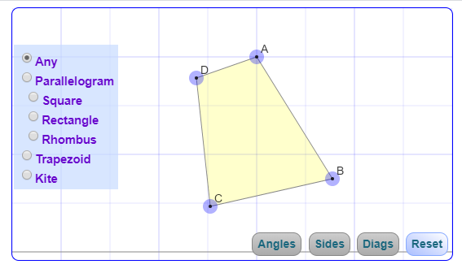
DRAWING TOOLS
QUADRILATERAL PROPERTIES
.
INFORMATION AREA. This section has to be populated with an image and definition of what is clicked
DRAWING AREA
PROPERTIES BOX
ANGLE
LENGTH
SUM OF ANGLES
RESET

Slide 2
DESIGN TEAM
BUILD A GOOD IMAGE FOR EACH OF THE MENU BUTTONS. – SEE BELOW LIST.
YOU HAVE TO CREATE MENU BUTTON AND AN IMAGE FOR DISPLAY.
CLICK ON A BUTTON AND CLICK IN DRAWING AREA. IT SHOULD DRAW THE CORRESPONDING OBJECT.
OBJECTS NEEDED
DRAWING TOOLS
RULER,
PROTRACTOR
LINE
LEFT HAND MENU ITEMS
QUADRILATERAL, PARALLELOGRAM, SQUARE,RECTANGLE, RHOMBUS, KITE, TRAPEZIUM,
ANGLE SUM PROPERTY
PROGRAMMING NOTES:
CLICK ON A BUTTON AND CLICK IN DRAWING AREA. IT SHOULD DRAW THE CORRESPONDING OBJECT GIVEN BY MEDIA TEAM.
(SEE NOTES ON LEFT)
DRAWING AREA –
NEEDS THE INTERACTIVE QUADRILATERALS BUILT BY VENKAT. CAN PARAM GEOMETRY LAYOUT AND VENKAT’S INTERACTIVE TRIANGLES WORK ON THE SAME DIV?
TEACHING GUIDE – WILL NEED DEFINITIONS FOR EACH ITEM AND EXPLANATION ABOUT THE VARIOUS MENU OPTIONS

Slide 3
DRAWING TOOLS
PARALLELOGRAM PROPERTIES
.
INFORMATION AREA. This section has to be populated with an image and definition of what is clicked
DRAWING AREA
PROPERTIES BOX
ANGLE
LENGTH
SUM OF ANGLES
RESET

Slide 4
Show title “Properties of Parallelogram”. Show the images on the left hand side menu. When user clicks, the theorem description should come in the information box along with a big image. See the next slide for the images.
INFORMATION AREA SHOULD SHOW THEOREM AND BIG IMAGE.
DRAWING AREA SHOULD BE AVAILABLE FOR THE TEACHER TO DRAW A PARALLELOGRAM AND DEMONSTRATE THE THEOREMS.
ADD PARALLELOGRAM TO THE DRAWING TOOLS (PARAM CODE)

Slide 5
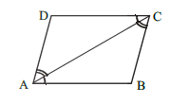
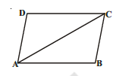
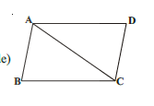
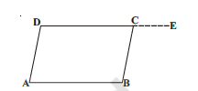
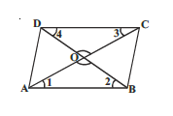
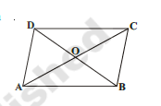
Theorem-1 : A diagonal of a parallelogram divides it into two congruent triangles.
Theorem-2 : In a parallelogram, opposite sides are equal
Theorem-3 : If each pair of opposite sides of a quadrilateral is equal, then it is a parallelogram.
Theorem-4 : In a quadrilateral, if each pair of opposite angles are equal then it is a parallelogram.
Theorem-5 : The diagonals of a parallelogram bisect each other.
Theorem-6 : If the diagonals of a quadrilateral bisect each
other then it is a parallelogram.

